Slide 1
Introduction to Bankruptcy Law and the Bankruptcy System: An Educational Primer for State Courts [Template Presentation For Educational Use]
This template presentation, provided by the Federal Judicial Center, combines, edits, and expands presentations given by bankruptcy judges and state trial court judges. Contact Jason A. Cantone, at fedstate@fjc.gov, for more information.
Notes:
This presentation was greatly benefitted by the following individuals, who reviewed an earlier draft of the presentation: Hon. Shon Hastings, Hon. Craig Whitley, Hon. Cate Furay, Hon. Charles L. Nail, Jr., Hon. Ashely Chan, Hon. Robert Kressel, Hon. Robert Drain, Hon. Diane Finkle, Hon. Robert Faris, Elizabeth Wiggins, and Brian Lynch. The presentation utilizes and expands on prior educational materials provided alongside interviews held by Dr. Jason Cantone with: Hon. Dan Collins, Hon. Brian Davis, Hon. Robert Faris, Hon. Cate Furay, Hon. Martin Glenn, Hon. A. Benjamin Goldgar, Hon. Mary Gorman, Hon. Laurel Isicoff, Hon. Catherine McEwen, Hon. Robyn Moberly, Hon. Mindy Mora, Hon. Chris Panos, Hon. Laura Taylor, and Ann M. Anderson. This presentation was made better by all of these individuals, as well as the Judicial Conference Committee on Federal-State Jurisdiction.

Slide 2
Content Note
This presentation only addresses the additional considerations. A full presentation with all six topics (bankruptcy overview; automatic stay; bankruptcy discharge; family law; foreclosure; additional considerations) is available at fjc.gov/fedstate, as well as separate presentations for each of those topics.
Notes:
If you would like a Powerpoint that includes the full presentation or the topics provided in the note, please visit fjc.gov/fedstate.

Slide 3
Additional Considerations and Resources

Slide 4
Additional Considerations
Advice: Compare bankruptcy schedules (which includes lists of debts, assets, income, and expenses) with the family law financial affidavit–especially in connection with contempt proceedings.
Advice: When you are directing payment to or for the benefit of one spouse from another, including any award of attorney fees or expenses, make very clear that it is in the nature of alimony, support, and maintenance and why. A mere label will not be binding on the bankruptcy judge who is required to make a finding unless your findings are specific.
Notes:
See In re Omine, 485 F. 3d 1305.

Slide 5
Additional Considerations
Advice: If a finding of fraud is the basis for a final judgment, include that finding when drafting the final judgment. The more specific the findings of fact, the greater likelihood that the issues will not be relitigated in a subsequent bankruptcy proceeding.
The same applies to verdict forms.
Specifically find how the damages are apportioned between torts, because the damages arising from one tort may be dischargeable while damages arising from a different tort may be excepted from discharge.
Notes:
See In re Mayorga, 362 B.R. 527; In re Kohr, 399 B.R. 284; In re Preston, 2007 WL 4707544.

Slide 6
Additional Considerations
Advice: If you suspect that one party may file bankruptcy upon a dissolution ruling, enter an order or judgment making a final determination of property rights of the parties as soon as practicable.
Advice: If you monetize an interest in the marital home, make sure the obligation is secured either by an equitable lien or an actual recorded mortgage.
Notes:
See In re Hoyo, 340 B.R. 100.

Slide 7
Additional Considerations
The defense of judicial estoppel is often raised by defendants in state court actions when the cause of action has not been scheduled by the debtor in the bankruptcy case.
Advice: Consider who would be harmed in the case by the application of judicial estoppel.
Debtor only or creditors?
Notes:
See In re Hoyo, 340 B.R. 100.

Slide 8
Additional Considerations
If a state court learns a former debtor failed to schedule a litigation asset in the bankruptcy case, the state court might want to direct the debtor to notify the trustee or court in writing of such failure and of the pendency of the state court litigation.
That way, the litigation asset may not be lost as an asset in the bankruptcy process.
Notes:
See In re Hoyo, 340 B.R. 100.

Slide 9
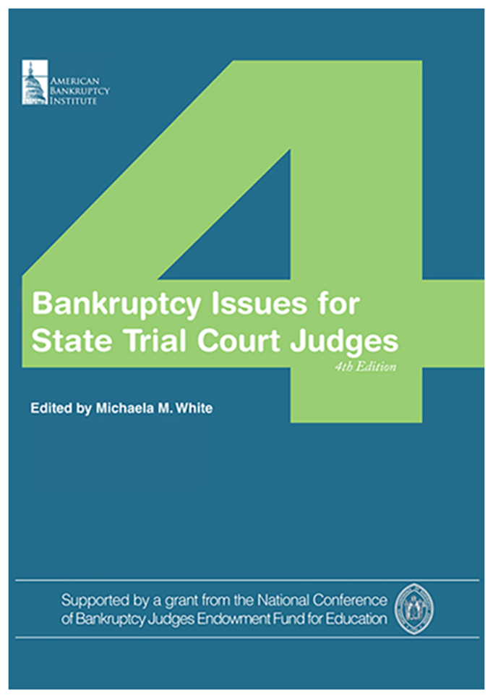
Additional Resources
Federal Judicial Center website on federal-state cooperation: https://fjc.gov/fedstate
National Center for State Courts resource guide on foreclosures: https://www.ncsc.org/Topics/Financial/Foreclosures/Resource-Guide.aspx

Slide 10
Thank You
This presentation was organized by Federal Judicial Center Senior Research Associate Jason A. Cantone, with considerable assistance by a number of federal and state judges and court personnel (see note for slide 1).
Questions about the presentation and its use can be directed to Dr. Cantone, at fedstate@fjc.gov. We would also like to hear from you if you find it helpful or have any recommendations to improve it.

